Slide 1

Charleston Strong:
From Tragedy to Healing
Civil Rights Resources for
Children and Teens
Jennifer Tazerouti
Karen Gavigan
NCSLMA Conference
October 2015

Slide 2
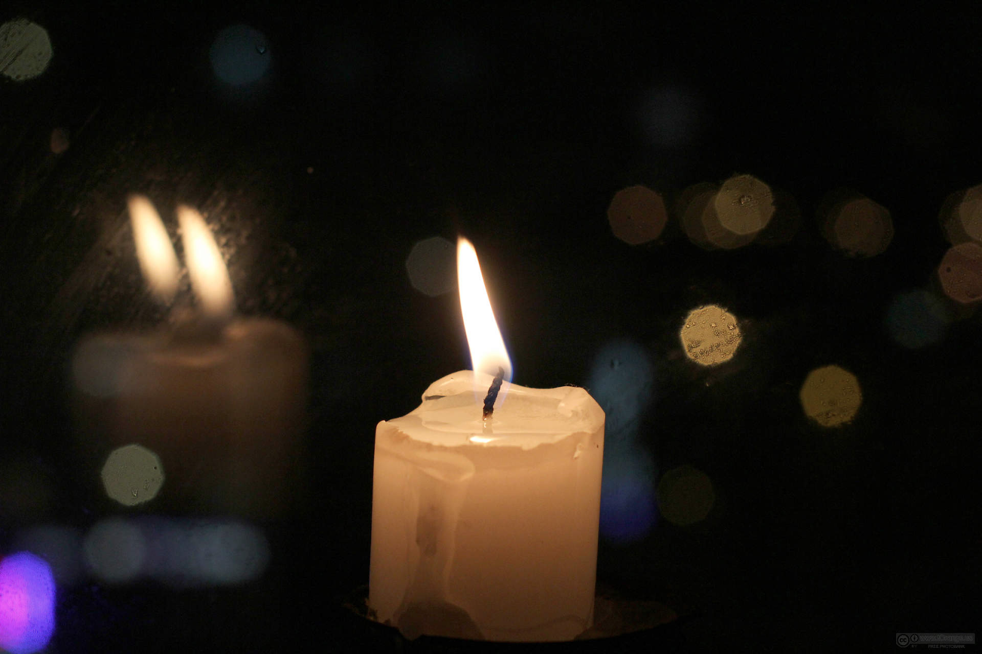
This presentation is dedicated to the memory of those who died in the shooting at Emanuel African Methodist Episcopal Church on June 17, 2015.

Slide 3
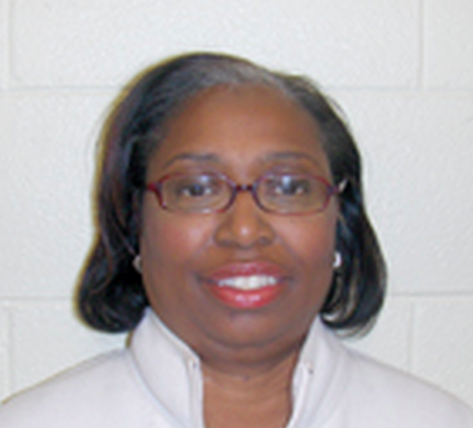
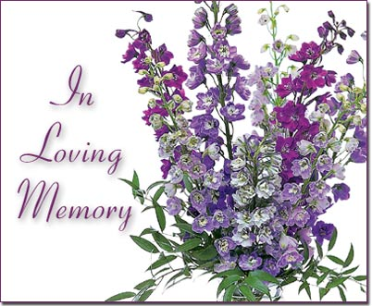
Cynthia Hurd
Worked for Charleston County Public Library for 31 years
USC SLIS Alumni

Slide 4
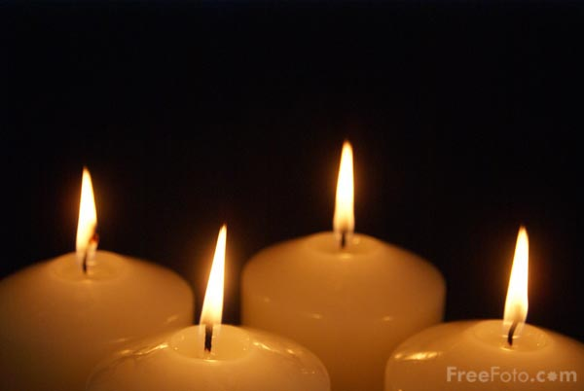
Susie Jackson
Ethel Lee Lance
Depayne Middleton-Doctor
Clementa C. Pinckney
Tywanza Sanders
Daniel Simmons
Sharonda Coleman-Singleton
Myra Thompson

Slide 5

How This Project Began
Writer for School Library Journal contacted Jennifer during ALA Annual San Francisco
#CharlestonSyllabus Created by professors and librarians from other states
  “List of readings that educators can use to broach conversations in the classroom about the horrendous events that unfolded in Charleston, South Carolina on the evening of June 17, 2015.”
SCASL recognized the need for a bibliography specific to children and youth for SC and beyond

Slide 6

First Steps
Wanted participation to be open to all
Invitation to “recommend resources about civil rights issues for children and teens, as well as suggestions for using them.”
Recognized our limitations
Role of social media

Slide 7

Open Source Bibliography
Available on the SCASL website
“Bibliography will be posted online, presented at conferences, and shared in countless ways by librarians, teachers, and parents in South Carolina and around the world.”
Contributors include librarians, teachers, authors, SLIS students, reviewers of children’s and YA literature, and more

Slide 8
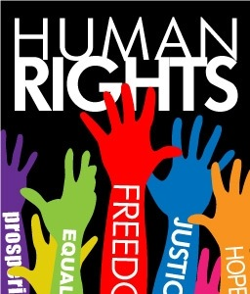
Civil Rights
As defined by Merriam-Webster, “the rights that every person should have regardless of his or her sex, race, or religion”
When children and youth understand civil rights and human rights issues, it can help them develop empathy and understanding for others.

Slide 9
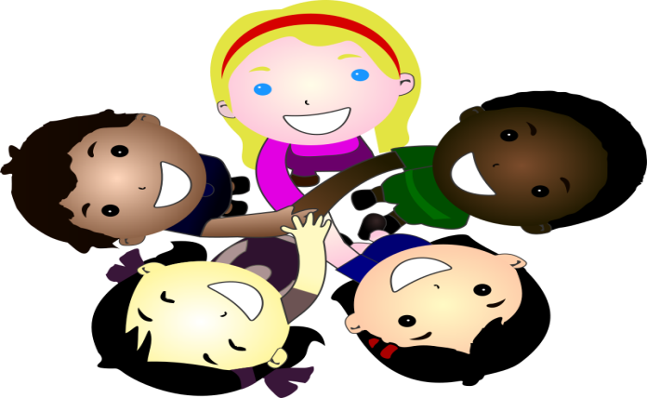
Mirrors and Windows
Children need books that show them a mirror—reflect their own identity and experience—and a window—that let them see into others’ experiences.
(metaphor from Rudine Sims Bishop, professor emerita of
The Ohio State University).

Slide 10
From an Author’s Perspective…
“I want to create characters that are non-white so kids of color can see themselves. What happens with that is other kids see themselves too.”
Jacqueline Woodson
Interview on About.Com

Slide 11
“Why Are They Always White?”
1965 - Nancy Larrick brought national attention to the need for multicultural literature with her seminal article “The All-White World of Children’s Books”
Out of 3,200 children's books published in 2013, only 93 were about black people, 34 about Native Americans, 69 about Asians and 57 about Latinos (Guardian website, May 1, 2014)

Slide 12
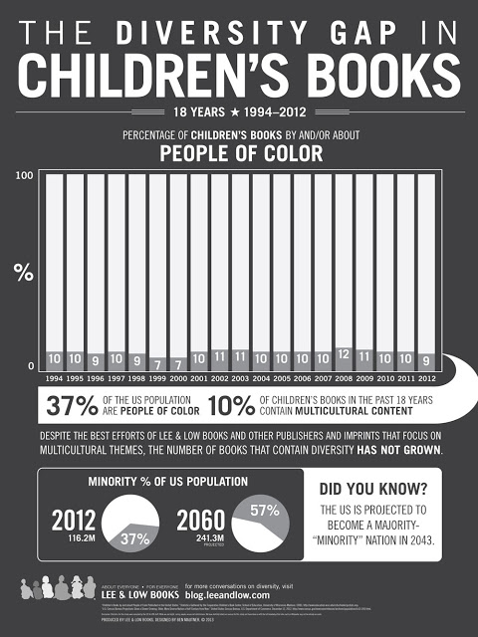

Slide 13
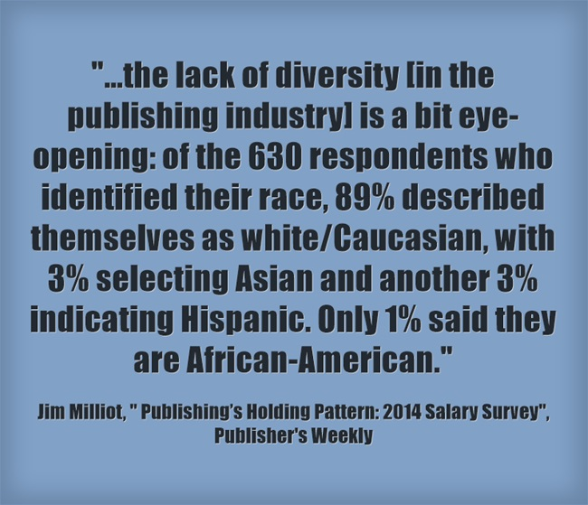
Publishing Industry –
Partly to Blame?

Slide 14
Charleston Strong Bibliography

Slide 15
Elementary School Recommendations
Images are courtesy of Follett’s Titlewave.

Slide 16
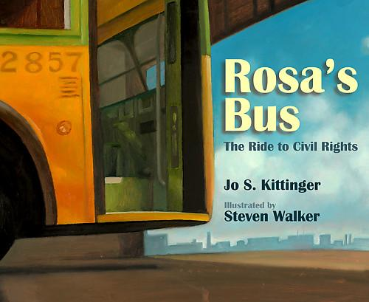
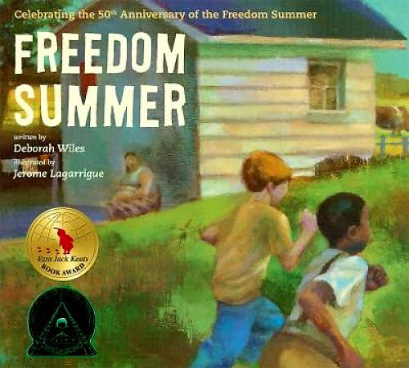
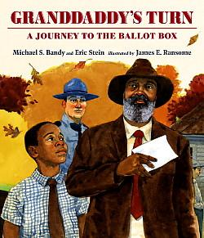
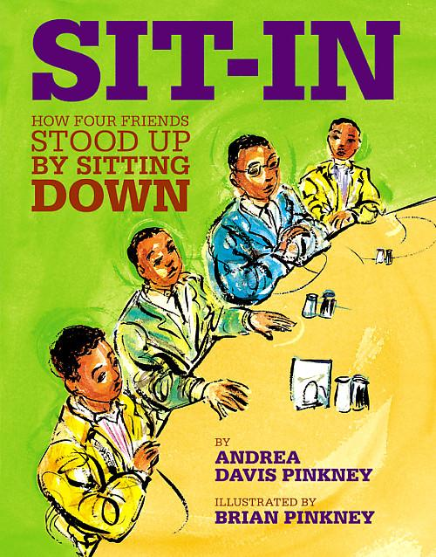
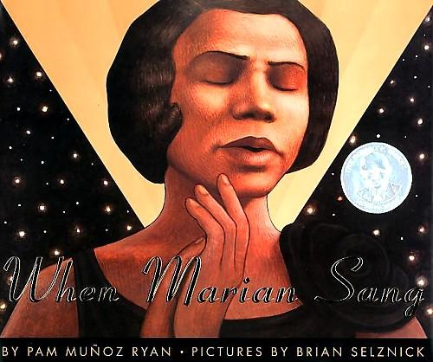
Picture Books / Biographies

Slide 17
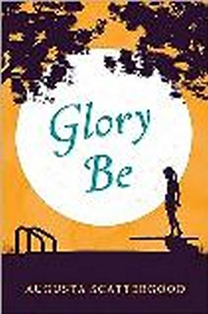
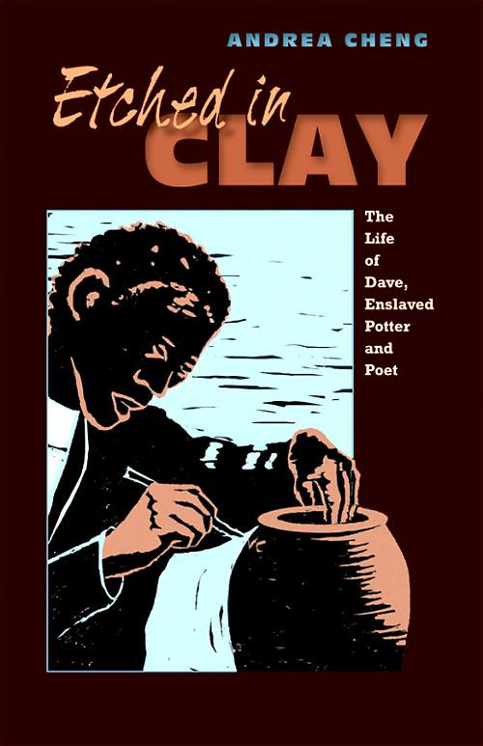
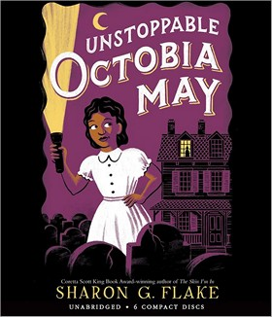
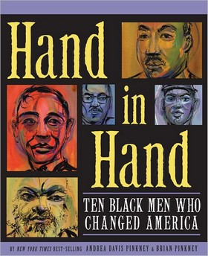
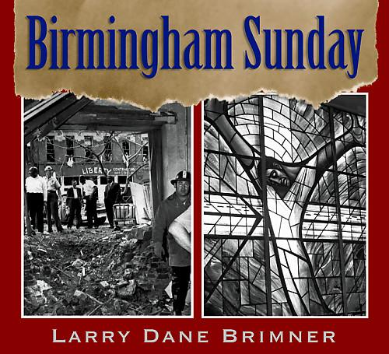
Chapter Books and Nonfiction Titles
Elementary

Slide 18
Middle School Recommendations
Images are courtesy of Follett’s Titlewave.

Slide 19
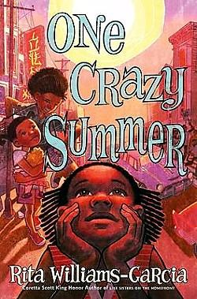
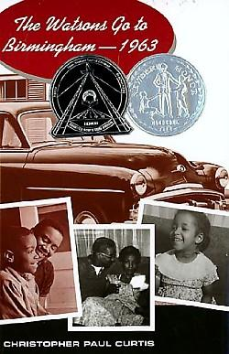
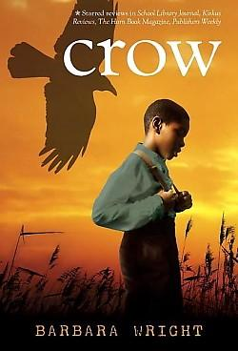
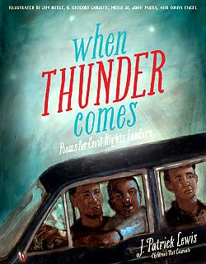
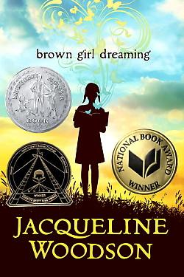
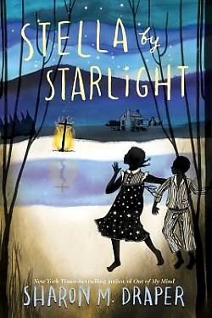
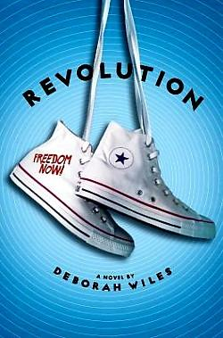
Fiction, Memoir and Poetry
Notes:
In One Crazy Summer –1968 three sisters journey from New York City to San Francisco California to meet their estranged mother and spend a month with her. Not wanting them around, their poet mother sends the girls off to a Black Panther Summer Camp. By the end of the novel, the girls have a new perspective to contrast with how their grandmother is raising them in NY – colored girls being careful to avoid scenes – to confident black girls who are proud of who they are.
Crow – offers another contrast of adult parent/guardian – set against a power historical backdrop of the 1898 Wilmington Race Riots, main character Moses’s grandmother – a former slave and his father – a newspaper man graduated from Howard. When the novel begins, Moses’s father is optimistic - There's a solid black middle class, thirteen of the twenty-four policemen are black, and fourteen percent of the black residents own their own homes. Unfortunately things change quickly and Moses is forced into the firestorm of the race riots.
Brown Girl Dreaming – has a dreamy tone as this memoir in verse Woodson weaves race, religion, history, family, geography and writing into an intimate tapestry of personal experience. The audio book is narrated by Woodson.
When Thunder Comes – from Booklist “. Seventeen civil rights leaders from around the world leap off the page, animated in pulsing verse and vibrant imagery. Lewis gives voice to a variety of fighters, including well-known activists like Mohandas Gandhi and Coretta Scott King, and less familiar heroes such as Dennis James Banks and Sylvia Mendez, illuminating each with poetic form, style, rhythm, and tone as individual as the subjects themselves.”
Everyone knows about The Watsons Go To Birmingham 1963 right? If you haven’t read it – put it at the top of your list. This book has it all – humor, family drama, and a biting historical backdrop. Fall in love with the Watson family and feel their pain as they witness a horrific Birmingham Church bombing. Because that is what it is all about – empathy and increasing our young readers bank of perspectives on the world.
Stella by Starlight – Set in 1932 segregated Bumblebee NC, meet 11 year old Stella and her family and learn about the struggles of registering to vote, segregation, and finding your voice.
Revolution – 1964 – Freedom Summer, Greenwood Mississippi. Told mostly from the perspective of white, 11 year old Sunny and occasionally from African American teenager - Ray’s point of view, this novel is sprinkled with a wealth of primary source material that provide readers with a backdrop & foundation of the plot.

Slide 20
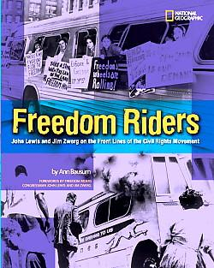
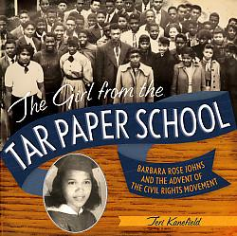
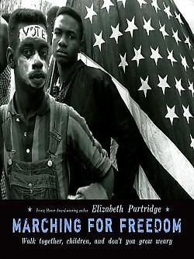
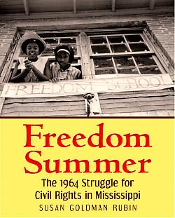
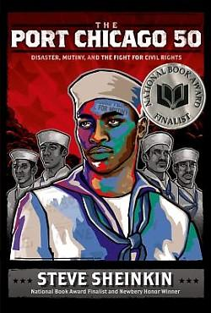
Non-Fiction
Notes:
Freedom Summer – Many volunteers came to Mississippi during the summer of 1964 to help African Americans register to vote and to open schools. This book gives a well researched account of these activities.
Freedom Riders – A biographical look at the Freedom Riders Movement through two perspectives – black and white.
When the Children Marched: The Birmingham Civil Rights Movement –A detailed book about the involvement of children in the Birmingham Civil Rights Movement
The Girl From the Tarpaper School – A biography of Barbara Rose Johns, this book details the strike she organized to protest the unfair conditions of her school.
Marching for Freedom: Walk Together, Children, and Don’t You Grow Weary. How did young people take part in the march at Selma? What events led to the march? This book provides a chronological view of the Selma march and tells how children and students played a critical role.
Claudette Colvin Twice Toward Justice – Who was the first person who refused to give up her seat on a bus? I ask my students when I book talk this title- Rosa Parks, they squeal. When the students find out that this is not true and they need to read this book to find out – the book flies off the shelf.
The Port Chicago 50 – Sheinkin delivers another fascinating historical narrative in this book about segregation and discrimination in the US Armed forces, the deadly explosion at Port Chicago and the African American sailors who were charged with mutiny after refusing to return to the same unsafe work environment after the explosion.

Slide 21
High School Recommendations
Images are courtesy of Follett’s Titlewave.

Slide 22
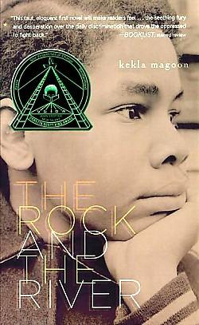
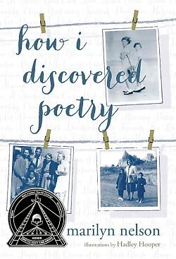
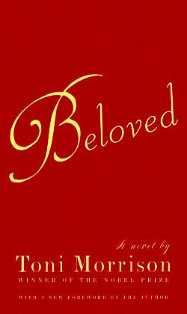
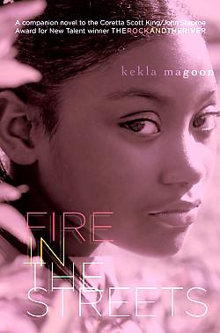
Fiction and Poetry

Slide 23
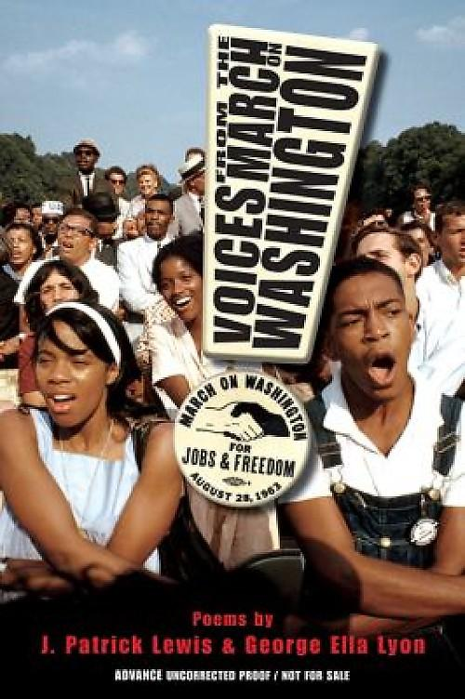
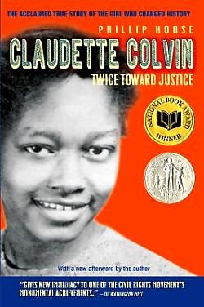
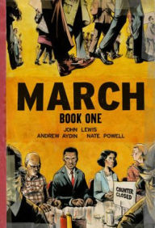
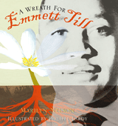
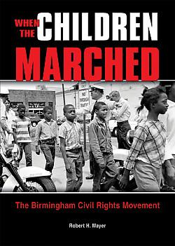
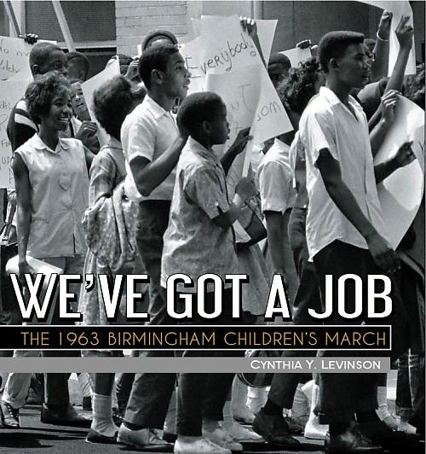
Nonfiction / Biographies

Slide 24

Welcome to the Teaching Tolerance website, a place where educators who care about diversity, equity and justice can find news, suggestions, conversation and support.
Magazine
Professional Development
Classroom Resources
Film Kits
Mix It Up
Publications
Webinars
Perspectives

Slide 25

We Need Diverse Books (WNDB)
WNDB & School Library Journal produced a book talking kit highlighting children’s literature about diverse characters and/or written by diverse authors.
http://weneeddiversebooks.org

Slide 26
Online Resources
National Museum of American History, Behring Center. “Bitter Resistance: Clarendon County, SC.” Smithsonian, n.d. Web. 16 October 2015. <http://americanhistory.si.edu/brown/history/4-five/clarendon-county-1.html>.
Howard, Anastasia. “Portrait of Civil Rights.” SC Department of Parks, Recreation & Tourism., 2004. Web. 16 October 2015. <http://dc.statelibrary.sc.gov/handle/10827/12029>.
SCETV. “Teacher’s Guide to Idella Bodie’s SC Women ETV Series.” SC Department of Education and SC Educational Television Commission, 2011. Web. 16 October 2015. <http://dc.statelibrary.sc.gov/handle/10827/13991>.
Four Little Girls. Dir. Spike Lee. Home Box Office, 1997. Film.
“South Carolina African American 2015 History Calendar.” AT&T of South Carolina, 2015. Web. 16 October 2015. <http://scafricanamerican.com/download/>.
“Road Trip! Through SC Civil Rights History.” ETV Commission, n.d. Web. 16 October 2015. <http://www.knowitall.org/roadtrip/>.
Bowen, Mae. “President Lyndon B. Johnson Signed the Civil Rights Act of 1964.” The White House Blog, 2 July 2015. Web. 16 October 2015. <https://www.whitehouse.gov/blog/2015/07/02/day-history-president-lyndon-b-johnson-signed-civil-rights-act-1964>.

Slide 27
Next Steps
We welcome your contributions today and / or in the future
Presentations at the NCSLMA and VAASL conferences this fall, and SCASL in the spring
Proposals for future national conferences
Article proposal

Slide 28
Current Bibliography Contributors
Patricia C. Bradley, Pam Cadden, April Dawkins, Susan Dicey, Sharon G. Flake, Karen Gavigan,
Diane Geddings, Joyce Hansen, Dianne Johnson-Feelings, Leigh Jordan, Thomas Maluck, Lindsay McKay, Karen Perry, Charleston Preston-Briegel, Fran Sanderson, Jennifer Simmons, Martha Taylor, Jennifer Tazerouti, Sarah Moise Young, Sharon Dennis Wyeth

Slide 29
From the Post & Courier
Charleston
“The mass murder at the church was a horrifying event, but it would make things even worse if we fail to learn all the lessons the tragedy might provide.”

Slide 30
Questions?

Slide 31

Contact Information
Karen Gavigan, Associate Professor, SLIS at USC
kgavigan@mailbox.sc.edu
Jennifer Tazerouti, SCASL President,
Teacher Librarian, Sims Middle School, Union
jtazerouti_sjh@union.k12.sc.us

Slide 32
Credits for Images
Shuler, Gil. Pray for Peace Palmetto image. Retrieved from Gil Shuler Graphic Design at http://www.gilshulergraphicdesign.com/we-shall-overcome/pray-for-peace

